Slide 1


Creation of production of microwave devices on the basis of nanostructured ceramics

Slide 2

Project resume
Objective
Expansion of microwave components production based on new ceramic materials, including new ferroelectric material (in bulk and thin film forms) for microwave controlled components and devices
Expansion of high-tech automated production of radio-electronic components including: varactors, phase shifters, adaptive antenna matching modules, as well as tunable filters, delay lines and generators in the Russian Federation. Construction of a production complex with required infrastructure, debugging and starting of production.
Production tasks
Business tasks
Marketing and sale in Russia and abroad, brand promoting in the global market. Entrance to the market with up-to-date components and devices developed on the basis of nonlinear nanostructured ferroelectric ceramics
A new class of microwave components based on linear and nonlinear composite ceramics, tunable components with high operation speed for microwave devices in a wide frequency range (0.3 - 80 GHz) for small, medium, and high levels of power (mW-kW) includes: phase shifters, phase modulators, adaptive matching elements for mobile telephony, tunable filters and pulse generators for broadband microwave systems.
Products
Notes:
2
2

Slide 3
Project background
Applicant
JSC SPC “Russian radioelectronics”
IP
Applicant has developed and patented compositions and methods of linear and ferroelectric ceramics including the thin film ones as well as a number of devices based on them (9 RF patents, 2 US patents).
Patent research revealed no obvious violation of the third parties’ rights when using technical solutions.
Project market
Global demand growth for products of microwave ceramics – an average annual demand growth for the next 5 years will amount to 8% since 2013. Market size in 2013 will reach 4130 million U.S. dollars.
Target countries – Russia, the U.S., Europe
The expected proceeds by 2018 – 2 billion rubles.
State
Project applicant has done considerable work on creation of product technology, carried out qualified and justified selection of equipment and licensed technology.
Applicant has resolved the issues with the supply of raw materials of required quality, made a list of alternative suppliers from various regional markets.
Existing plans for a creation of manufacturing enterprise are feasible and reasonable.
Site for the development of the project is optimal both in technological and economic parameters.
The proposed solutions of process equipment layout, network and technological support allow to achieve the claimed characteristics of future production.
Notes:
3
3

Slide 4
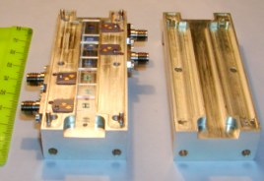
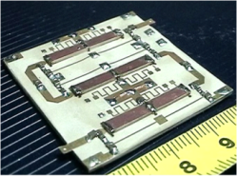
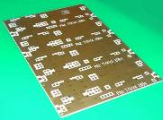
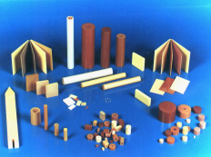
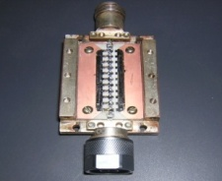
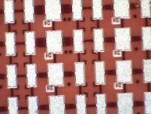
Products and scope
Tunable filters and generators
Phase shifters, delay lines and phase modulators BPSK, QPSK.
Telecommunication and radar equipment of low, medium and high power
Telecommunication and radar equipment of low, medium and high power
Active adaptive matching microwave modules Transceivers (next generation of mobile telephony)
Linear ceramics
Ultra –short pulse generators
UWB location, biomedicine,
monitoring and detection systems, tunable microwave generators
In radio - receiving and transmitting systems, telecommunication,
radar equipment as well as in radio relay and navigation systems of microwave band
Variconds (varactors)
Elements of phase shifters,phase modulators, filters, delay lines

Slide 5


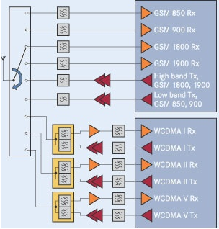
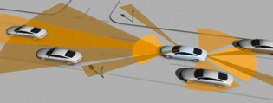
“Hot” Applications
Cell phone and mobile computers:
Taking the phone in hand, we create interference to signal transmission
Modern cell phone is a very multifunctional device, it is considered to support several frequency bands, providing Bluetooth, Wi-Fi, LTE communications. All of those systems require bandpass filters or filter banks. It is clear, that the reduction of area occupied by filters provides more free space for new function.
Antenna is mismatched with amplifier. Amplifier increases signal power
Battery
faster discharged
filters
Antennas actually used in smart mobile devices like cell phones do not have automatic tuning of its impedance. Thus, impedance of antenna is being affected by human body parts like, for instance, hands. Impedance variations leads to mismatch between antenna and amplifier. Modern cell phones compensates this effect by providing a higher power to the amplifier output signal resulting to a reduction of stand alone time up two times.
Anti-collision radars and communication systems:
up to now commercial solutions on the market are based only on mechanical scanning of antenna beam or on an array of non-scan antennas, which are very cost-intensive and not robust solutions.

Slide 6













Geography of consumers
Sale of finished products will be made ​​through the existing channels of sales in Russia, Europe and the U.S.,
as well as through intermediaries.
30% of sales
30% of sales
30% of sales
A number of consumers provided "comfort letters" with the confirmation of an interest and support in the project products.

Slide 7
Main project risks
Risk area | Main risks | Impact on the project | Methods of risk minimizing and control
Technology | Failure to achieve the stated product characteristics | Minimum | Current (achieved) level corresponds to the world standard Conducting of continuous research and development with the constant introduction of results into production. Existing prototypes correspond to R & D targets
 | Possibility of crossing of technical project solutions with patents existing in target regional markets | Medium | As part of the project the patenting of technology will be organized in the Russian Federation and target markets. The existing patent pool covers much of technology
 | Competitors‘ access to the project know-how | Significant | Protection as a trade secret. Constant development of technology.
Market and sale | Lack of demand for the products of the project | Minimum | Demand is considerably higher than production capacity The wide range of products and markets on the same technological base
 | Tightening of price competition in overseas markets | Medium | Continuous upgrading of the production process efficiency. Continuous development of technology.
 | Distrust of foreign consumers to Russian products | Significant | Implementation of project products at the stage of customers’ R & D Localization of the final production processes in the target area Participation in international projects Public access to information on the project and product

Slide 8
Marketing strategy of the project
Diversified approach
Products
Markets
Technologies
Differentiation on unique properties
Entry into new markets
General technological platform
Ferroceramic
Brand-new
Wide range
Special design for customer
Implementation on R&D stage
Quick changeover
Gaining customers’ confidence
Cost effective technology
(Know-how)
Test batches
Linear ceramics
Improved properties
Wide range
Special design for customer
Small batches
Easy scaling of output
Mass market

Slide 9
Required investment
Production design
Buildings
Development of space-planning solutions
Drawing of general and situation plan
Expertise
Rent and reconstruction of facilities of about 1500 sq.m total area at industrial plant
R&D
422
4.512
1.414
Total required investment
24.662 million. dollars.
Equipment
34 units of required technological equipment
Among them:
22 units of the required measuring and test equipment
Among them:
Chamber furnaces and polishing machines
Rattlers and jet mills to obtain ceramic nanoparticles
DC vacuum coaters
Microwave Signal Generators
Digital Oscilloscopes
Vector Network Analyzers
Spectrum Analyzers
18.316
Installation and commissioning of equipment
Ion-etching apparatus
Disk-cutting machine
Cold molding isostatic press

